Slide 1
ECON8320 Final Project
MiG Shyaka

Slide 2
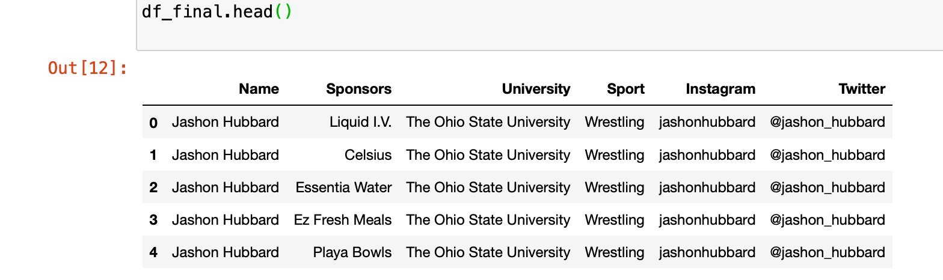
Problem
Collect and organize the information about student-athlete NIL deals found on https://nilcollegeathletes.com to an external site., https://www.on3.com/os/ to an external site. or other NIL sources. Collect information about each athlete:
School
Sport
Sponsorships
Athlete's social media accounts

Slide 3
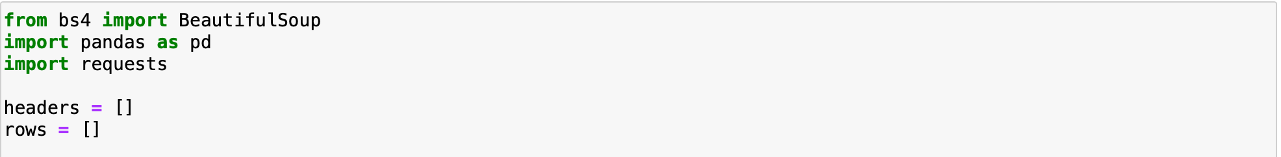
Methodology
BeatifulSoup
Pands
Request

Slide 4
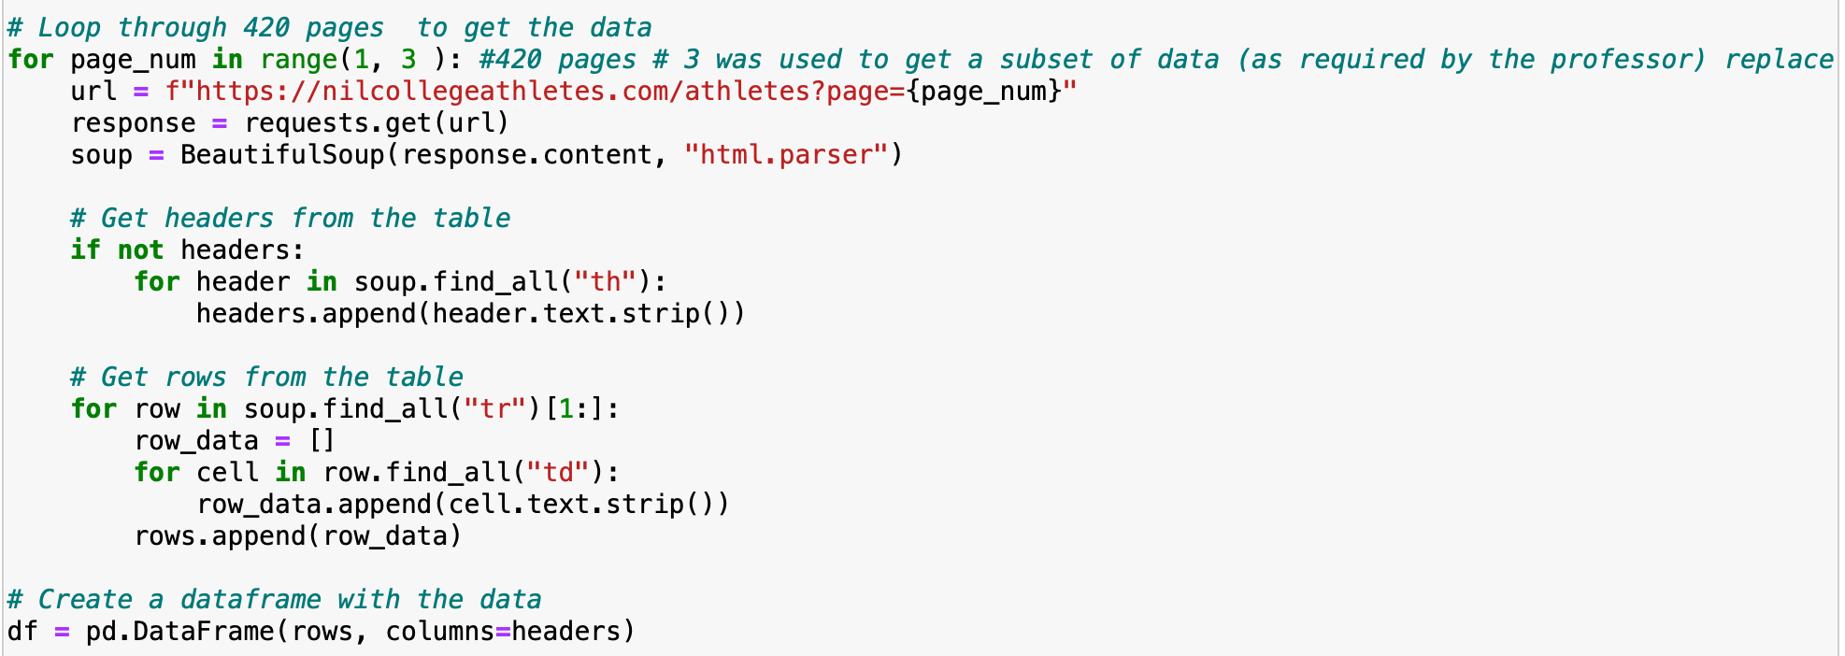

Slide 5
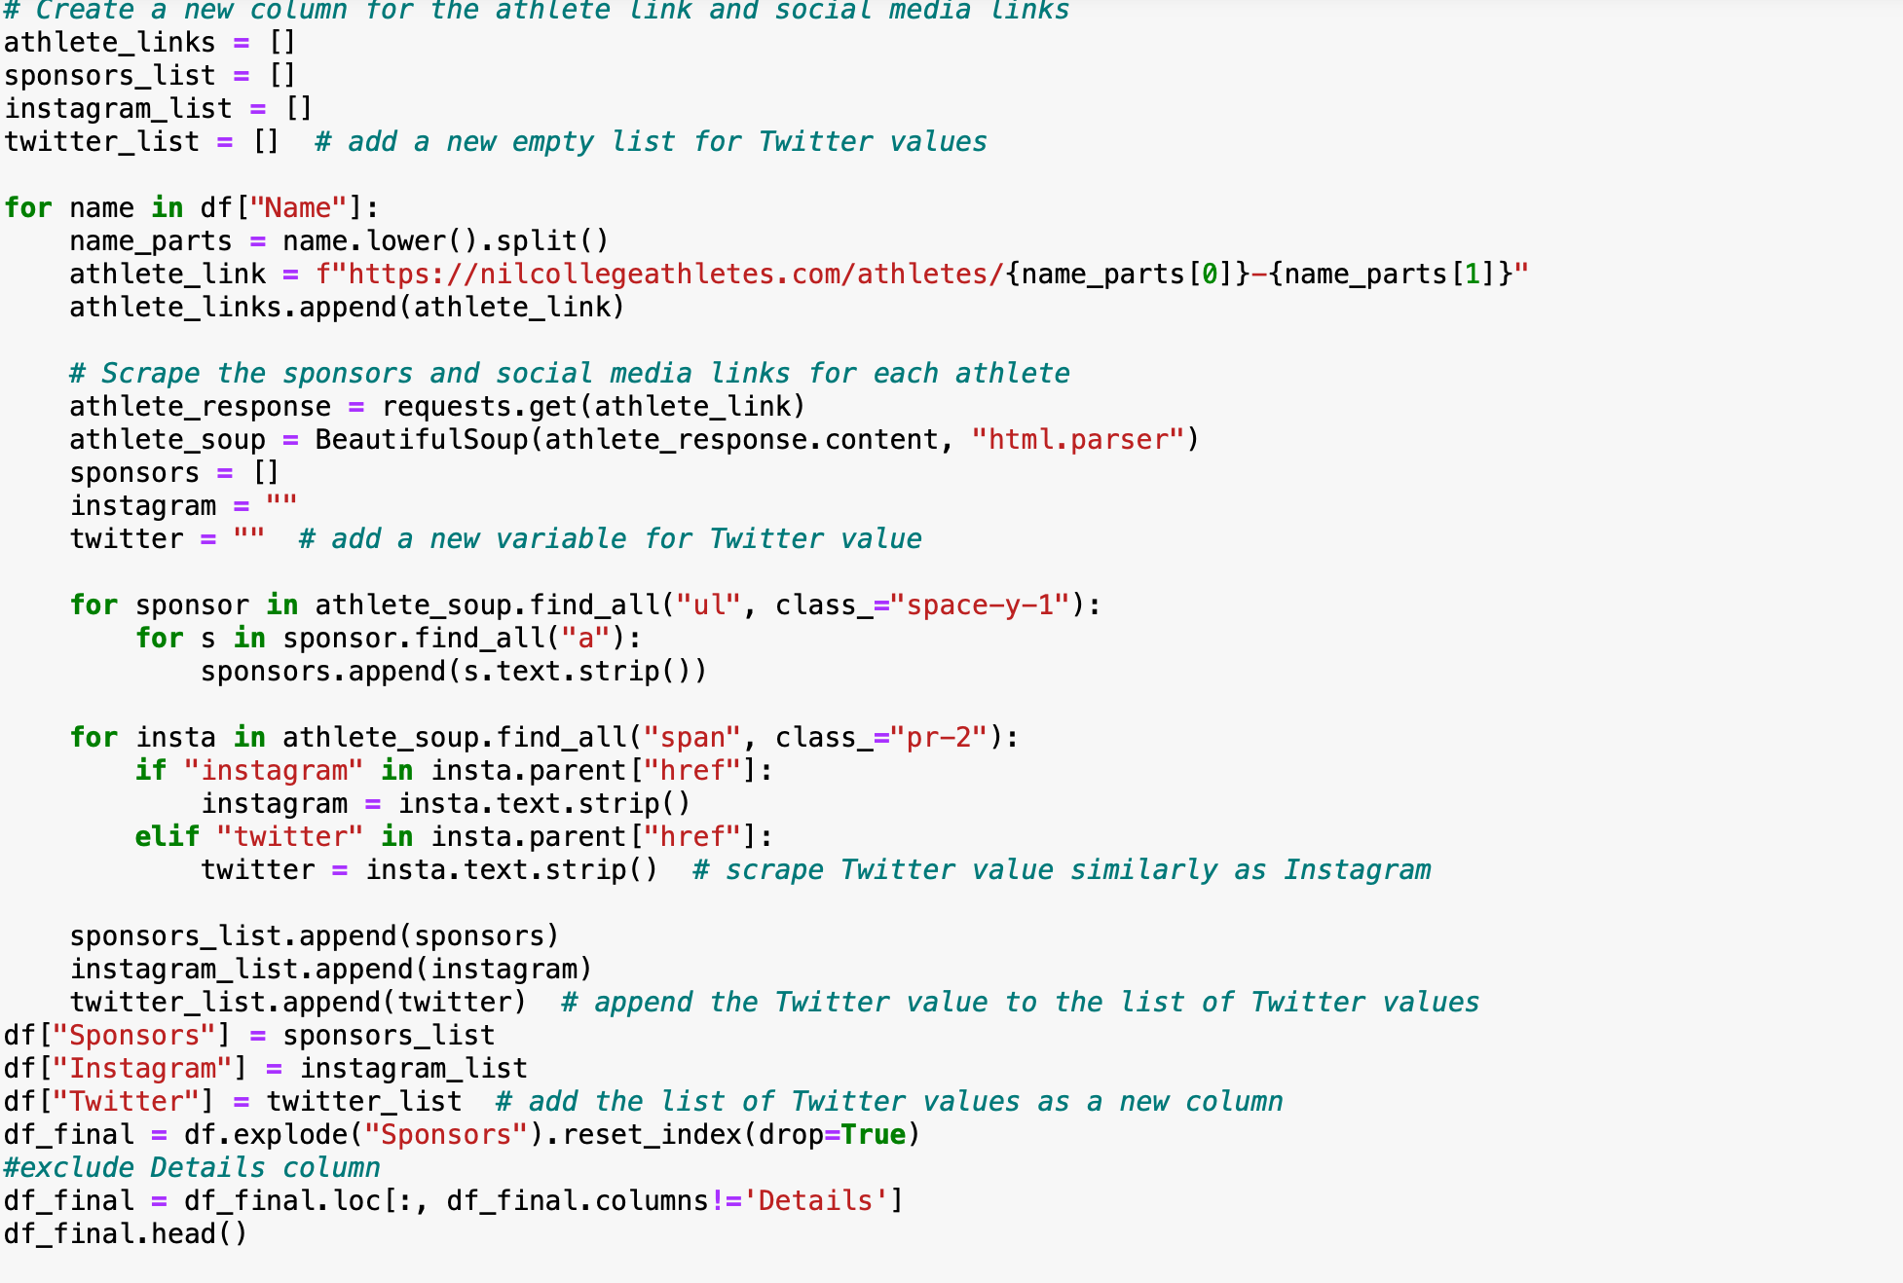

Slide 6
Results

Slide 7
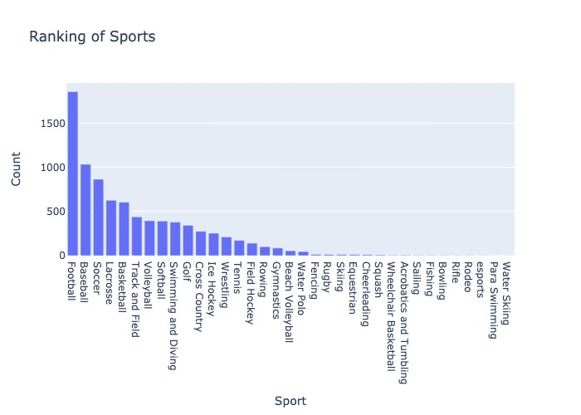
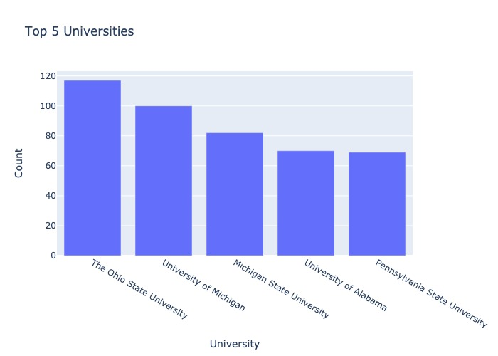

Slide 8
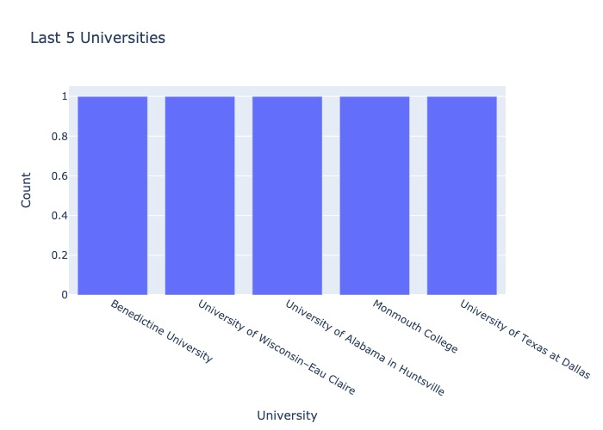
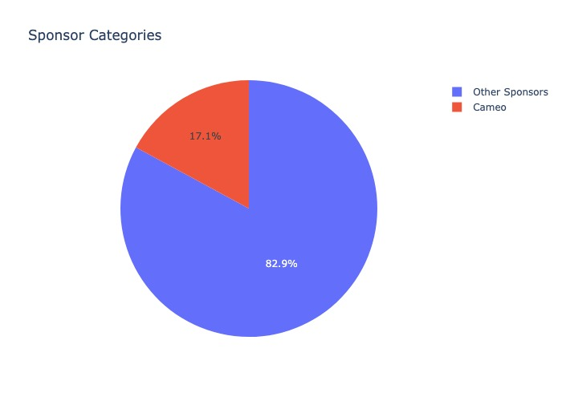

Slide 9
Challenges
HTML tags
Processing time

Slide 10
Conclusion & Future Work
Implementing Multiprocessing to speed execution time.
Extracting sponsor value
Overall, this project provided valuable insights into the emerging world of student-athlete NIL deals, and demonstrated the challenges and opportunities involved in collecting and organizing data from web sources.

